Slide 1












TRACE-X
Intelligent Cyber Incident Response & Containment
Problem 92 — Cyber Incident Response Planner
TEAM MEMBERS
Aarav Sharma
Neha Verma
Rohan Mehta
Ishita Singh

Slide 2



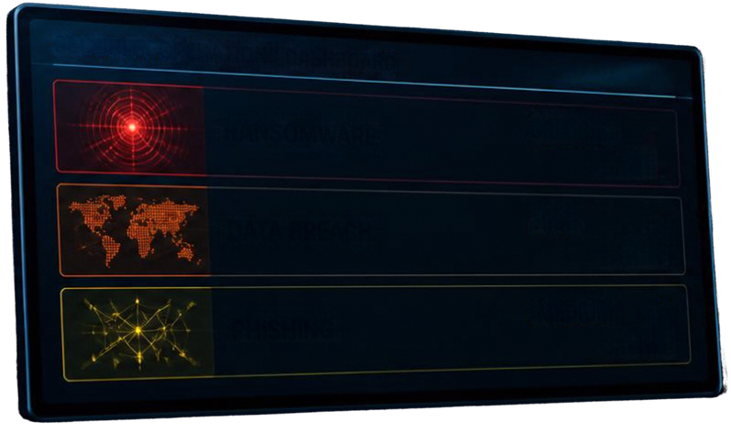





WHEN AN ATTACK HAPPENS, DETECTION IS ONLY
THE BEGINNING
01
WHAT FIRST?
Which incident to
handle immediately
SECURITY OPERATIONS DASHBOARD
WHAT IS AT RISK?
02
RANSOMWARE
CRITICAL
Which connected
systems are affected
DATA BREACH
HIGH
03
HOW TO CONTAIN?
PHISHING
MEDIUM
Most efficient
containment route
The challenge is not just detecting threats —
it is making the right response decision quickly.

Slide 3















TRACE-X
CYBER INCIDENT
TRACE-X transforms cyber incidents into explainable, algorithmm-driven response plans.
PRIORITY QUEUE
What should we handle first?
BFS GRAPH TRAVERSAL
What systems are potentially affected?
DIJKSTRA SHORTEST PATH
What is the efficient containment route?
RESPONSE PLAN

Slide 4








THREE ALGORITHMS. THREE CRITICAL DECISIONS.
01
PRIORITY QUEUE
02
BFS
Decides what to handle first
Determines what is at risk
Severity
Traces reachable connected systems
Impact
Critical Assets
Estimates
Priority Score
blast radius
03
DIJKSTRA
Determines how to contain
Calculates minimum cost/distance route

Slide 5

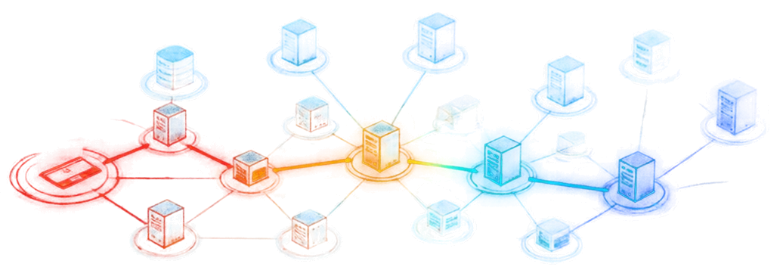











INCIDENT
RECONSTRUCTION
Instead of simply displaying a cyber alert, TRACE-X reconstructs what happened and explains what should happen next.
01
02
03
04
05
06
ENTRY POINT
ATTACK SPREAD
CRITICAL ASSET
PRIORITY
CONTAINMENT
RESPONSE PLAN
Identify compromised system
BFS traces connected systems
Identify important systems in blast radius
Priority Queue determines response urgency
Dijkstra finds efficient containment route
Generate explainable response

Slide 6






















HOW TRACE-X WORKS
USER
REACT
FRONTEND
API
FLASK BACKEND
DAA ALGORITHM
ENGINE
RESPONSE
PLAN
incident processing
& graph management
interactive
dashboard
PRIORITY QUEUE
BFS
DIJKSTRA
TECHNOLOGY:
PYTHON
FLASK
REACT

Slide 7








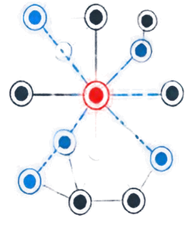
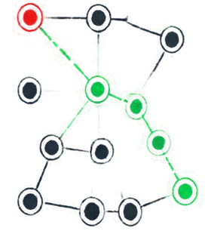












FROM INCIDENT TO ACTION
INCIDENT DASHBOARD
NETWORK ANALYSIS
CONTAINMENT
ALERTS BY PRIORITY
BLAST RADIUS VIEW
RESPONSE PLANNER
CRITICAL
12
ALGORITHM
Compromised Node
Dijkstra
Immediate attention
BFS
Traversal
SHORTEST PATH
HIGH
23
7
hops
Investigate next
Affected
Systems
RECOMMENDATION
Isolate the path and contain the target
MEDIUM
41
Monitor closely
FASTER PRIORITIZATION
CLEAR BLAST-RADIUS VISIBILITY
EXPLANABLE CONTAINMENT
Focus on what matters first
Understand the full impact
Confident actions with clarity

Slide 8





TRACE-X
Trace the Threat. Plan the Response.
Priority Queue → What First?
BFS → What’s at Risk?
Dijkstra → How to Contain?
THANK YOU
Priya Desai
Rohan Mehta
Neha Verma

